Slide 1
Assumptions and Properties of IRT Models
EDUC 8720

Slide 2
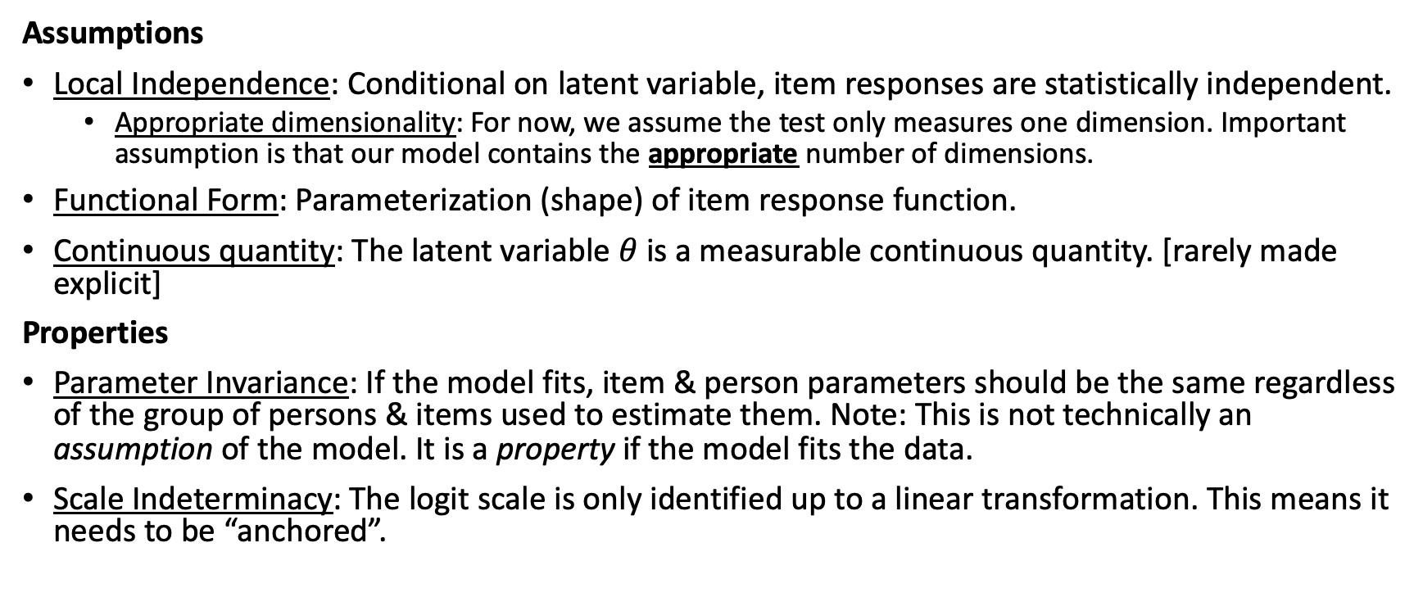
IRT Model Assumptions and Properties
Assumptions
Local Independence: Conditional on latent variable, item responses are statistically independent.
  Appropriate dimensionality: For now, we assume the test only measures one dimension. Important assumption is that our model contains the appropriate number of dimensions.
Functional Form: Parameterization (shape) of item response function.
Continuous quantity: The latent variable $θ$ is a measurable continuous quantity. [rarely made explicit]
Properties
Parameter Invariance: If the model fits, item & person parameters should be the same regardless of the group of persons & items used to estimate them. Note: This is not technically an assumption of the model. It is a property if the model fits the data.
Scale Indeterminacy: The logit scale is only identified up to a linear transformation. This means it needs to be “anchored”.

Slide 3
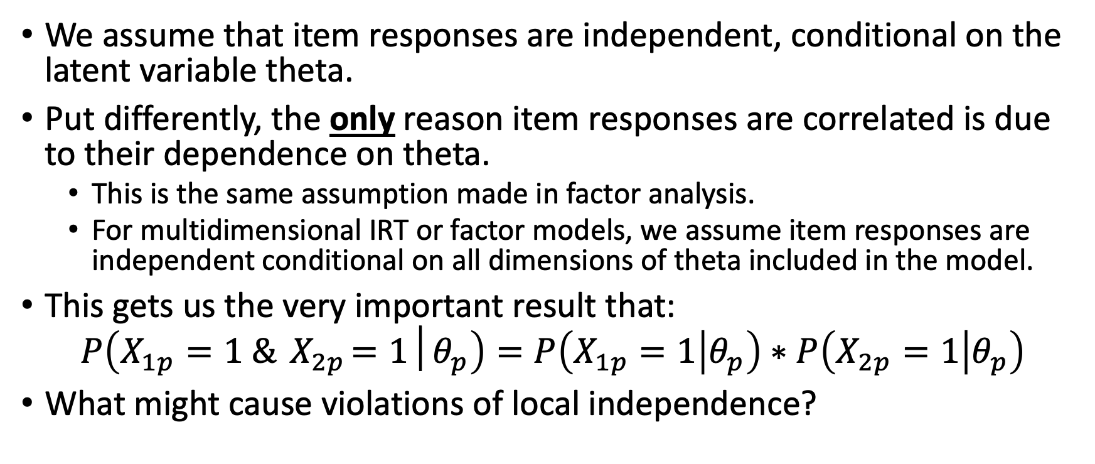
Assumption of Local Independence
We assume that item responses are independent, conditional on the latent variable theta.
Put differently, the only reason item responses are correlated is due to their dependence on theta.
  This is the same assumption made in factor analysis.
  For multidimensional IRT or factor models, we assume item responses are independent conditional on all dimensions of theta included in the model.
This gets us the very important result that:
$$P\left(X_{1p}=1 \&{ X}_{2p}=1│θ_{p}\right)=P\left(X_{1p}=1 | θ_{p}\right)∗P\left(X_{2p}=1 | θ_{p}\right)$$
What might cause violations of local independence?

Slide 4
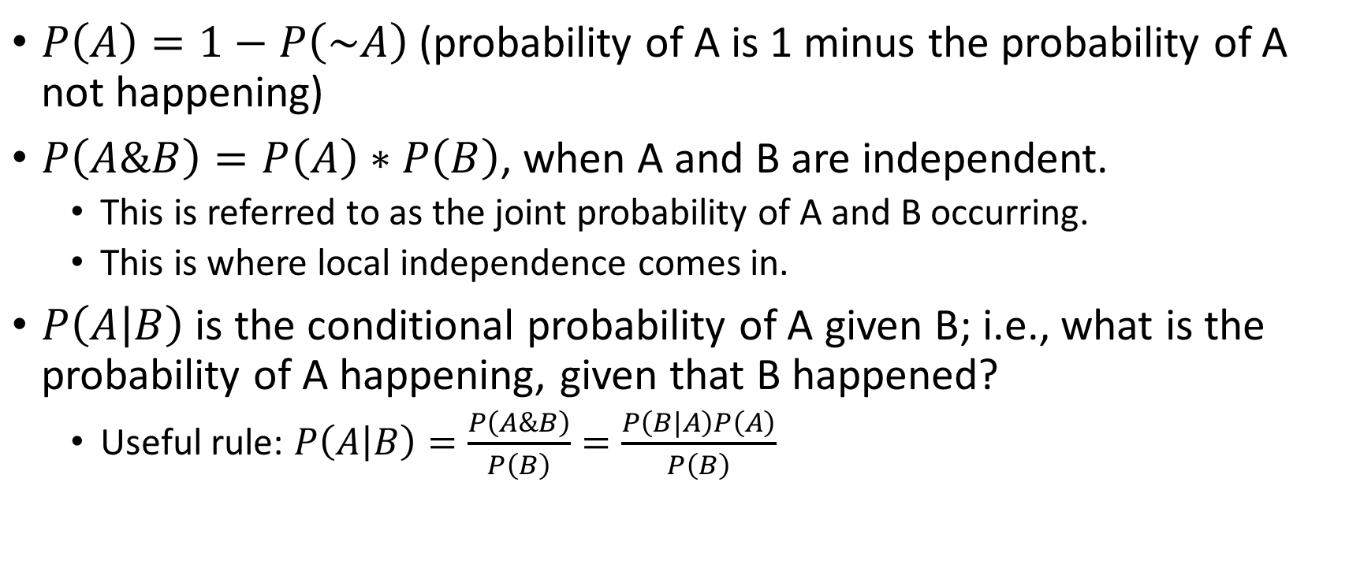
Quick Aside: Useful Probability Rules
$P\left(A\right)=1−P\left(\sim A\right)$ (probability of A is 1 minus the probability of A not happening)
$P\left(A\&B\right)=P\left(A\right)∗P\left(B\right)$, when A and B are independent.
  This is referred to as the joint probability of A and B occurring.
  This is where local independence comes in.
$P\left(A | B\right)$ is the conditional probability of A given B; i.e., what is the probability of A happening, given that B happened?
  Useful rule: $P\left(A | B\right)=\frac{P\left(A\&B\right)}{P\left(B\right)}=\frac{P\left(B|A\right)P\left(A\right)}{P\left(B\right)}$

Slide 5
Dimensionality
If a test is multidimensional and we fit only a single latent variable, could cause local item dependence.
Note that the dimensionality refers to the number of latent variables needed to model the response data.
  This may or may not correspond to the hypothesized dimensionality of the theoretical construct.
Most IRT models used in practice are unidimensional.

Slide 6
Assumption of ICC Form
We assume that the probability of correct responses follows the logistic form or normal ogive shown earlier.
Key characteristics are:
  Monotonically increasing probability as function of (one) theta.
  S-shape of the logistic (or normal ogive) curve.
  Can describe this with the a/b/c parameters.
  Note that there are IRT models with more parameters.

Slide 7
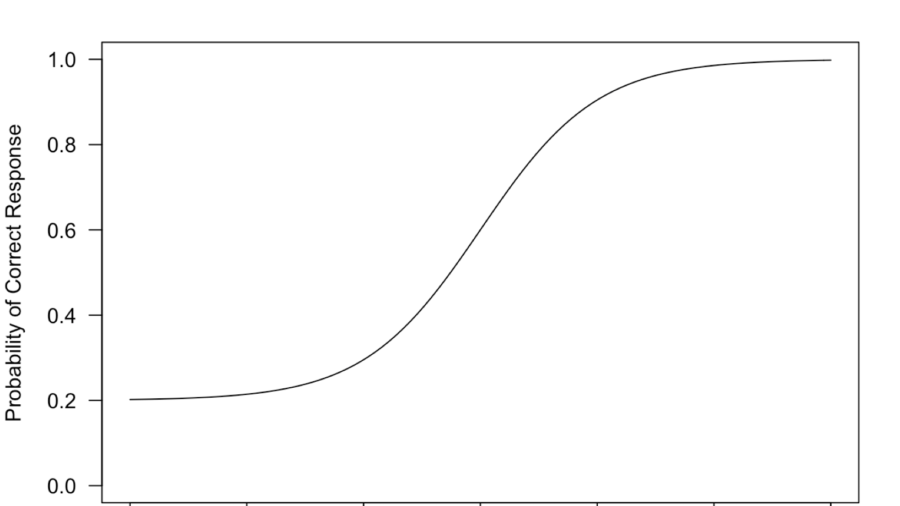
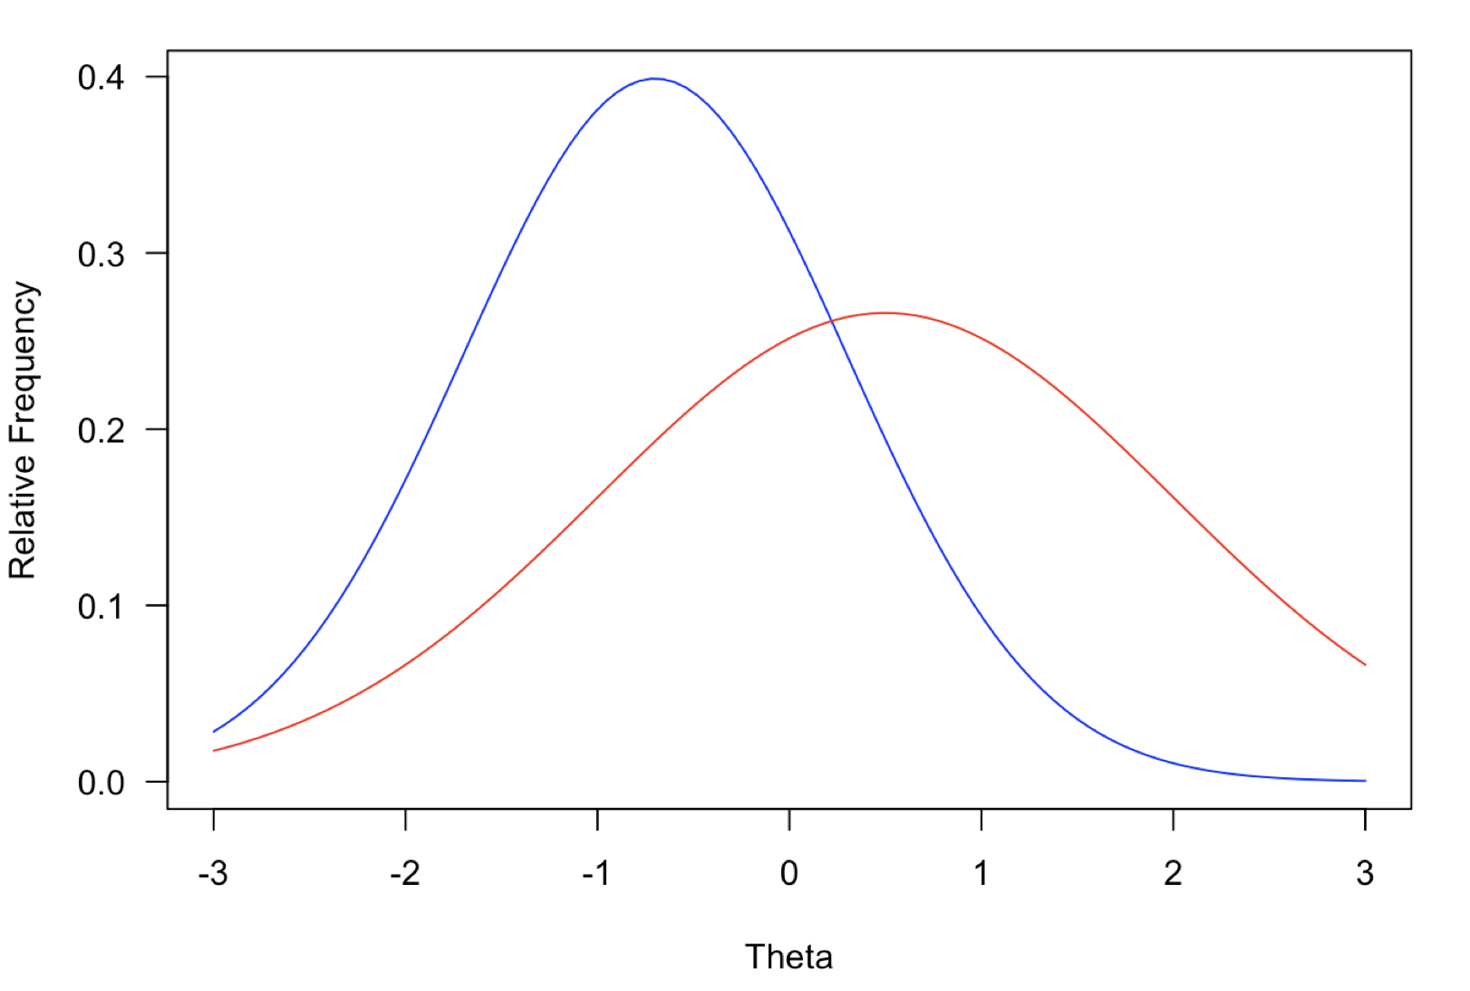
Parameter Invariance
If the model fits the data, item parameter estimates should be the same regardless of group used to estimate data.
We should get same a/b/c parameters from either the red or blue group.
If using CTT, we would expect very different item p-values from these groups.
A strong assumption, but can be checked empirically.
Same assumption made, e.g., in linear regression – we assume the slope and intercept are same regardless of group used to estimate the model.

Slide 8
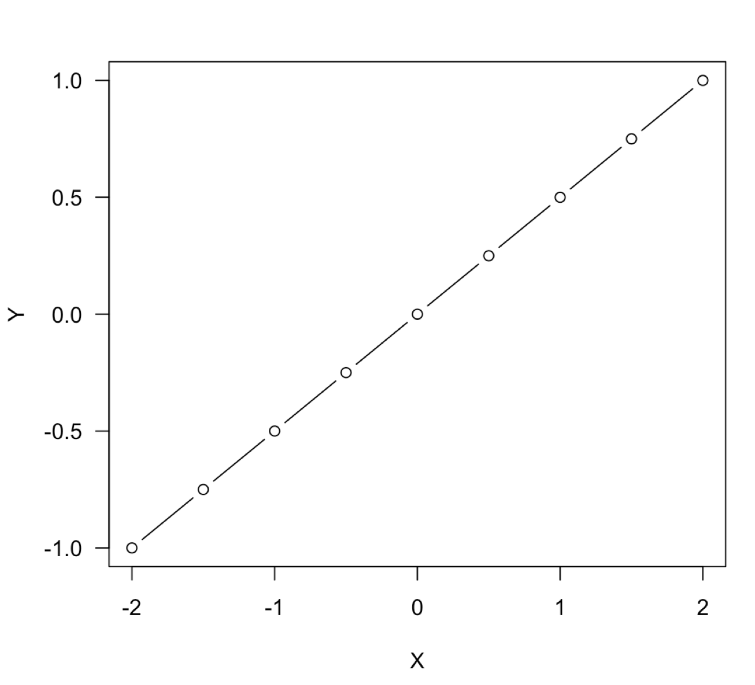
Parameter Invariance Analogy: Linear Regression
In this example, the continuous variables X and Y have been standardized.
We have values of X and Y for a complete population of interest.
Each point on the plot represents the expected value of Y given a specific value of X.
The corresponding regression line, which fits perfectly in this case, has a slope parameter that is invariant as a function of X.
I get the same slope estimate at both the blue points and red points. It doesn’t matter which section of X and Y data I observe.

Slide 9
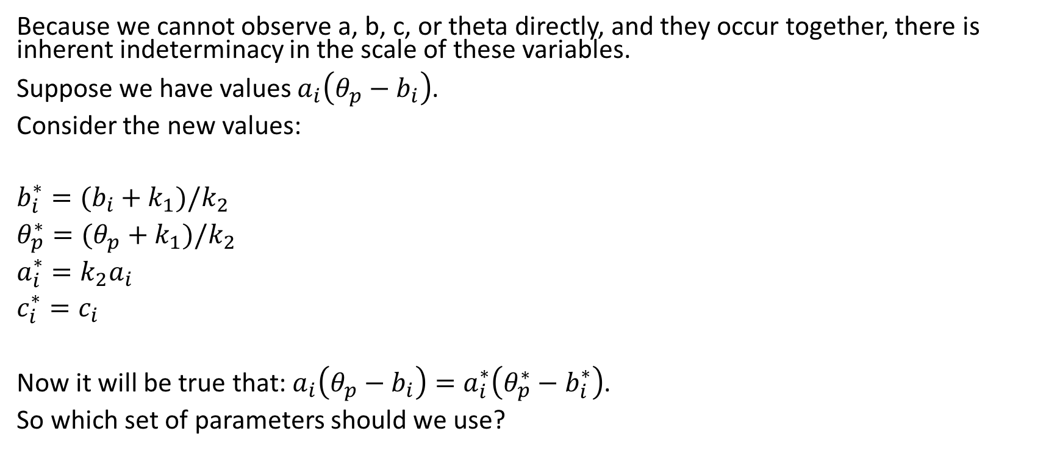
Scale Indeterminacy
Because we cannot observe a, b, c, or theta directly, and they occur together, there is inherent indeterminacy in the scale of these variables.
Suppose we have values $a_{i}\left(θ_{p}−b_{i}\right)$.
Consider the new values:
$b_{i}^{∗}=(b_{i}+k_{1})/k_{2}$
$θ_{p}^{∗}=(θ_{p}+k_{1})/k_{2}$
$a_{i}^{∗}=k_{2}a_{i}$
$c_{i}^{∗}=c_{i}$
Now it will be true that: $a_{i}\left(θ_{p}−b_{i}\right)=a_{i}^{∗}\left(θ_{p}^{∗}−b_{i}^{∗}\right)$.
So which set of parameters should we use?

Slide 10
Resolving Scale Indeterminacy
There are two main approaches.
Item-Side Anchoring
  Place constraints on the item parameters (e.g., average item difficulty is 0).
  Freely estimate the theta distribution.
  More common in Rasch modeling and in Europe.
Person-Side Anchoring
  Fix distribution of theta to have mean of 0 and SD of 1.
  Freely estimate the item parameters.
  More common in US and in achievement testing.
We will return to this when we learn how to estimate the parameters.

